Slide 1






AlphaFold training session
Jasper Zuallaert
Kenneth Verstraete
Alexander Botzki

Slide 2
Session outline: what to expect today
The post-AlphaFold protein structure prediction era
AlphaFold availability
Interpreting the outputs
Example use-cases and pitfalls
Hands-on: How to run your own AlphaFold experiment on the HPC
Hands-on: Visualizing the outputs
Hands-on: Protein complex predictions with AlphaFold
Hands-on: ColabFold and ESMFold platforms
https://elearning.vib.be/courses/alphafold/

Slide 3
The post-AlphaFold protein structure prediction era: an introduction

Slide 4

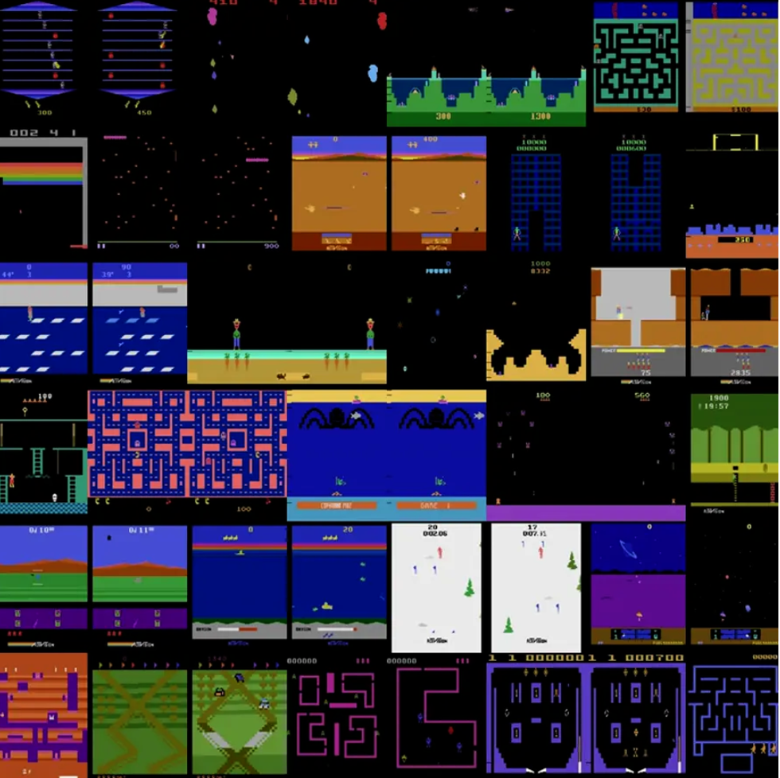
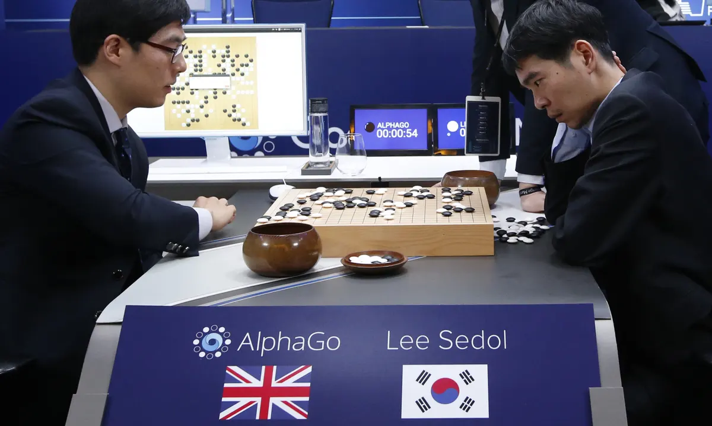
DeepMind: a timeline
2014
2015
2016
2017
2018
2019
2020
Founded in 2010
AlphaZero beats AlphaGo (100-0) and self-teaches chess/shogi
AlphaFold (2.0) wins CASP14
Acquired by Google for $500M
AlphaFold (1.0) wins CASP13
AlphaGo beats Lee Sedol (4-1)
Agent57 surpasses human level performance on all Atari2600 suite games

Slide 5
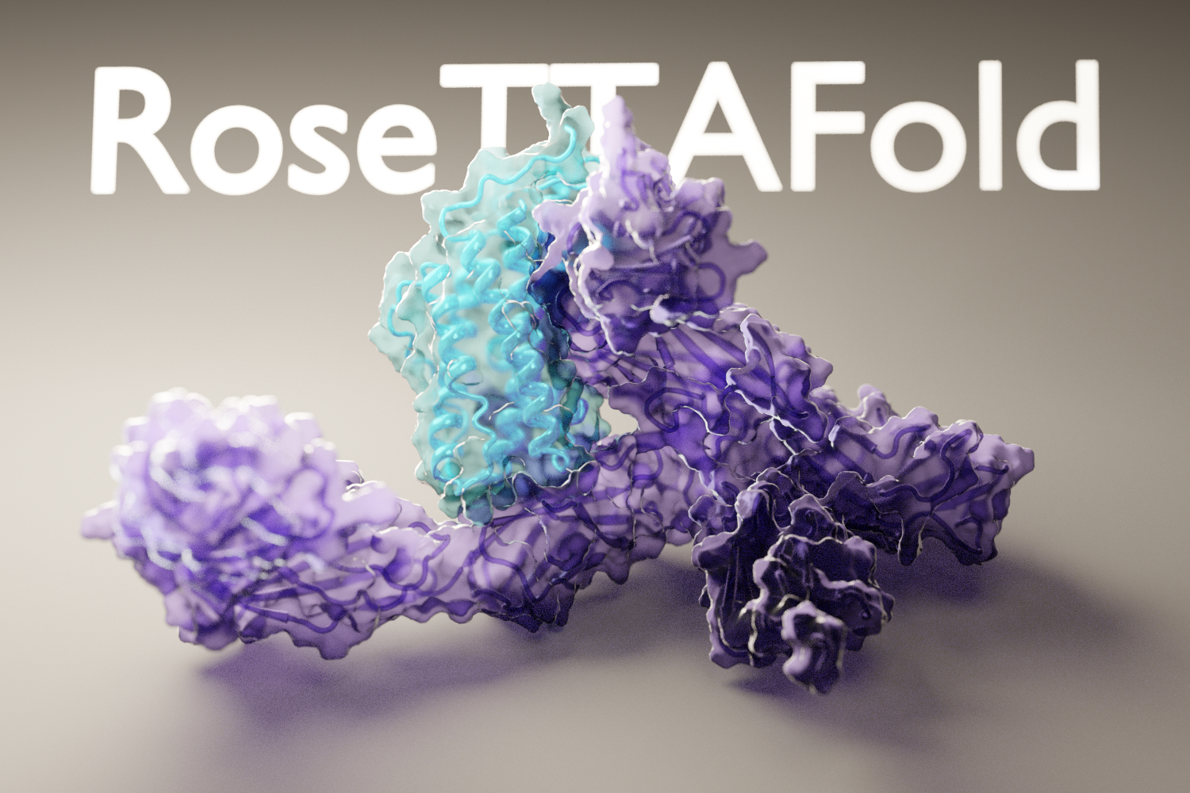
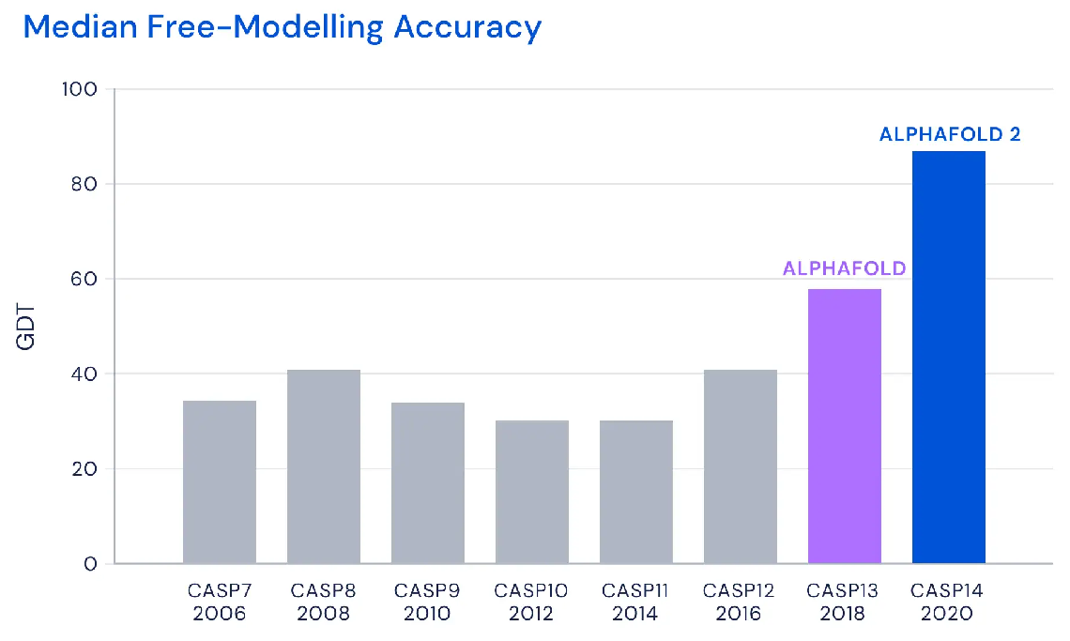
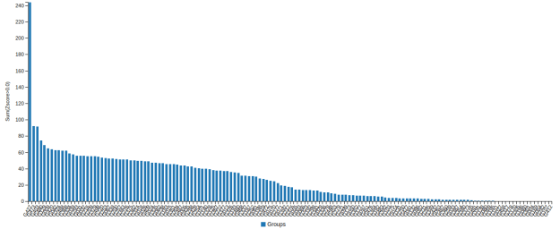
Critical Assessment of Structure Prediction (CASP14, 2020)
AlphaFold2
+ ideas from
Baker lab
CASP14, performance over all targets
Median of 92.4 across all targets, 87.0 in free-modelling accuracy

Slide 6
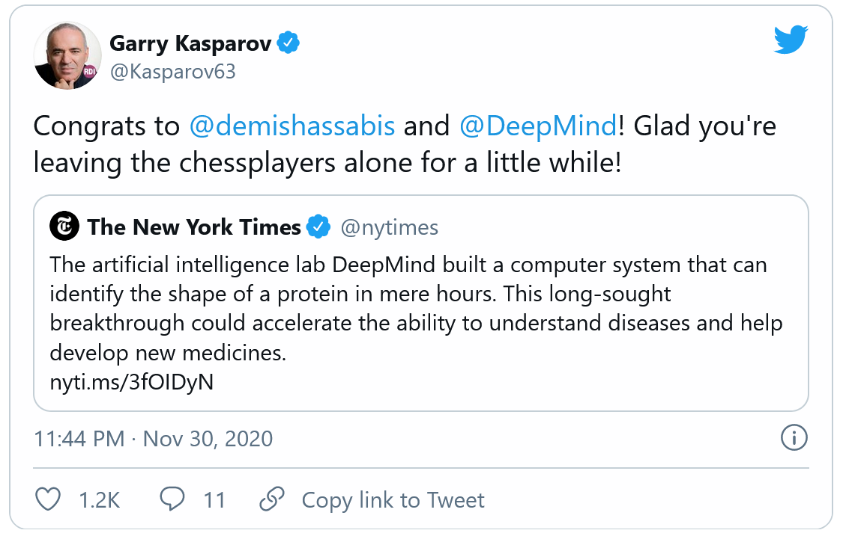

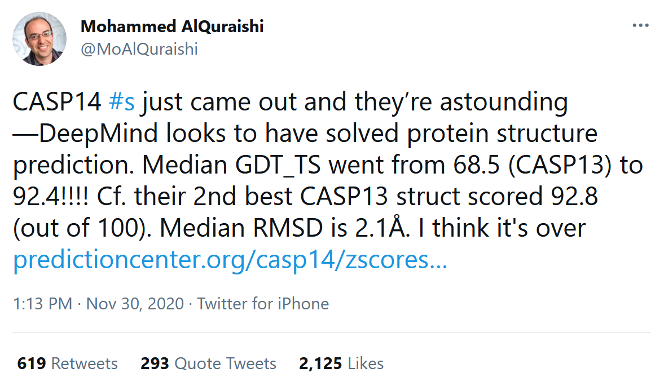
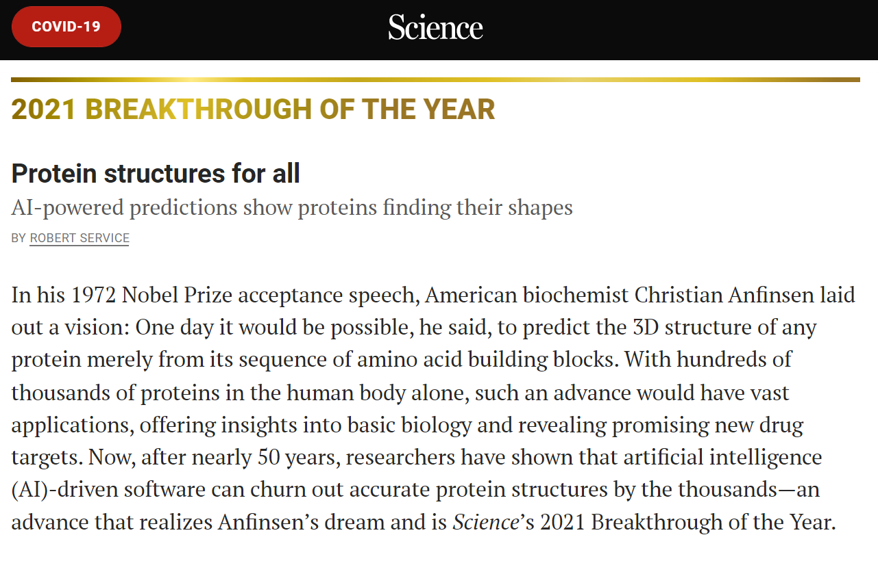
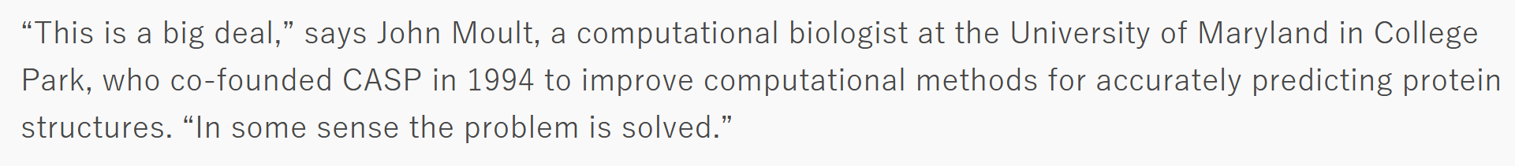
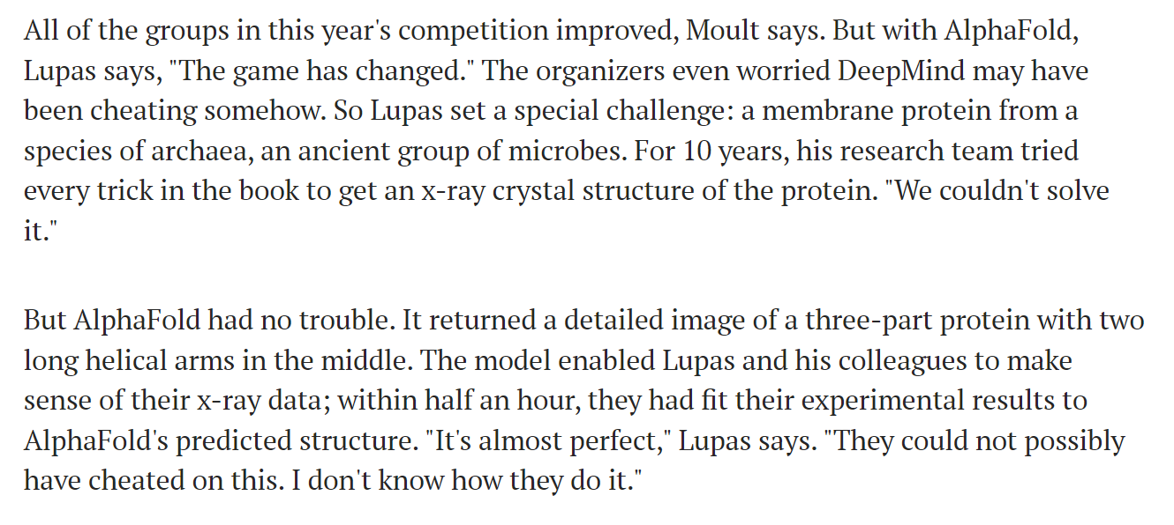
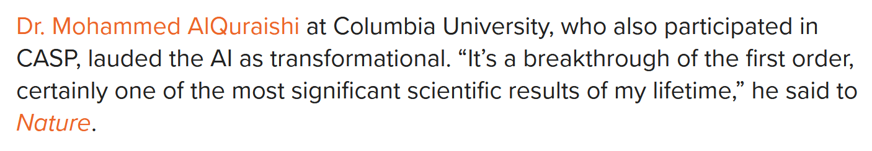
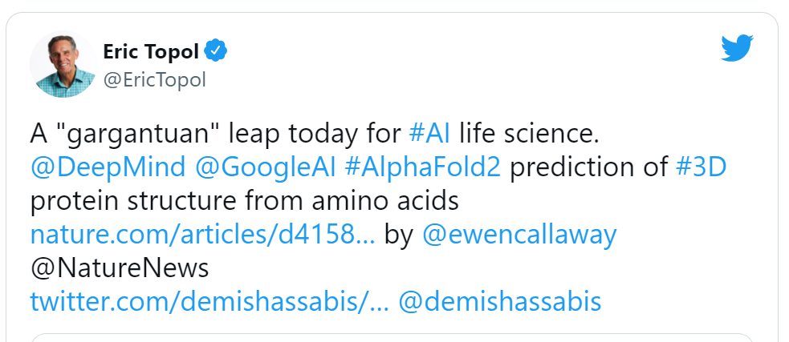
Reception of Alphafold 2

Slide 7
Protein structure prediction: post-AF timeline
CASP14
AlphaFold available on HPC (UGent, GPU)
AlphaFold-multimer available on HPC (UGent, GPU)
CASP15
2020
2021
2022
2023
RoseTTaFold: bioRxiv preprint + code
AlphaFold multimer paper
AlphaFold v2.2.0
AlphaFold v2.3.0
RoseTTaFold2: bioRxiv preprint + code
OmegaFold: release of language-model-based structure predictor
AlphaFold2: Nature publication + code
AlphaFold v2.1.0 multimer code+models
ESMFold: Meta releases language-model-based predictor
AlphaFold Protein Structure Database (with EMBL-EBI) released
OpenFold: bioRxiv preprint + code

Slide 8
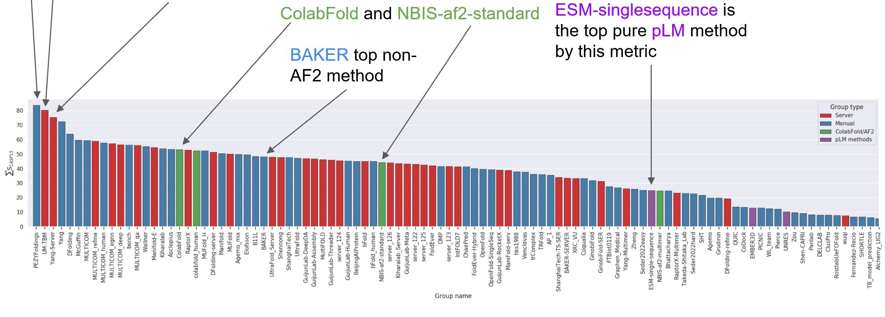
Critical Assessment of Structure Prediction (CASP15, 2022)
Complex prediction competition:
→ Afsample = 6000 predictions per target (+ select best)
<-> default AlphaFold: 5 (v1) / 25 (v2) per target
(image source: Twitter @AlbertVilella)

Slide 9
AlphaFold: pipeline and basic principles

Slide 10
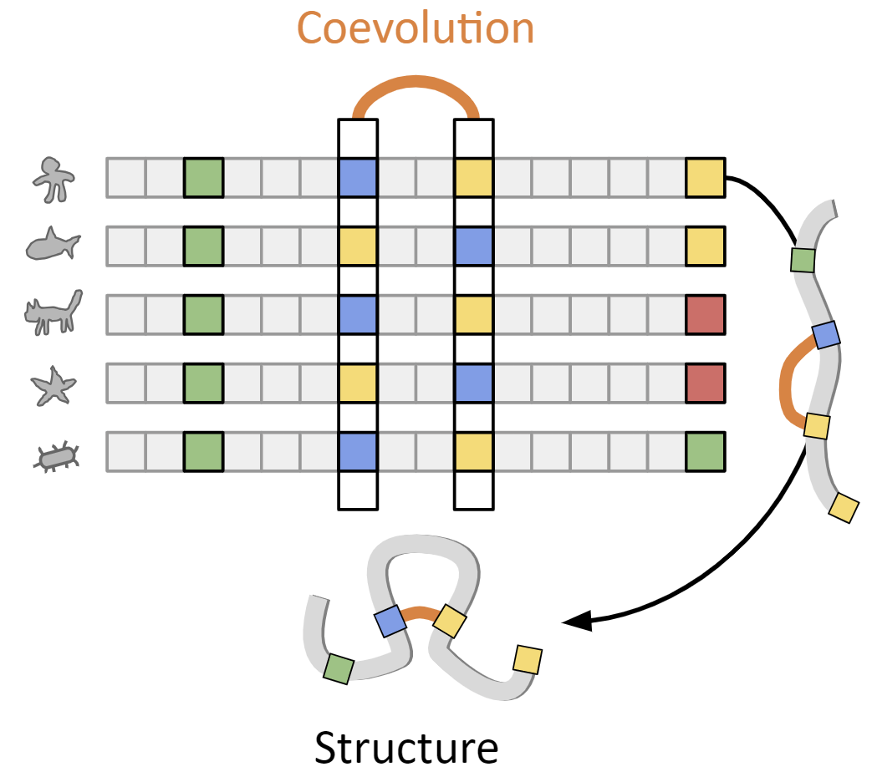
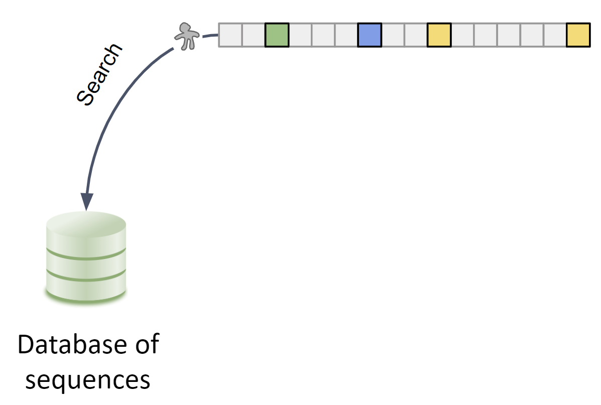
AlphaFold depends on coevolutionary information captured by MSAs (multiple sequence alignments)

Slide 11
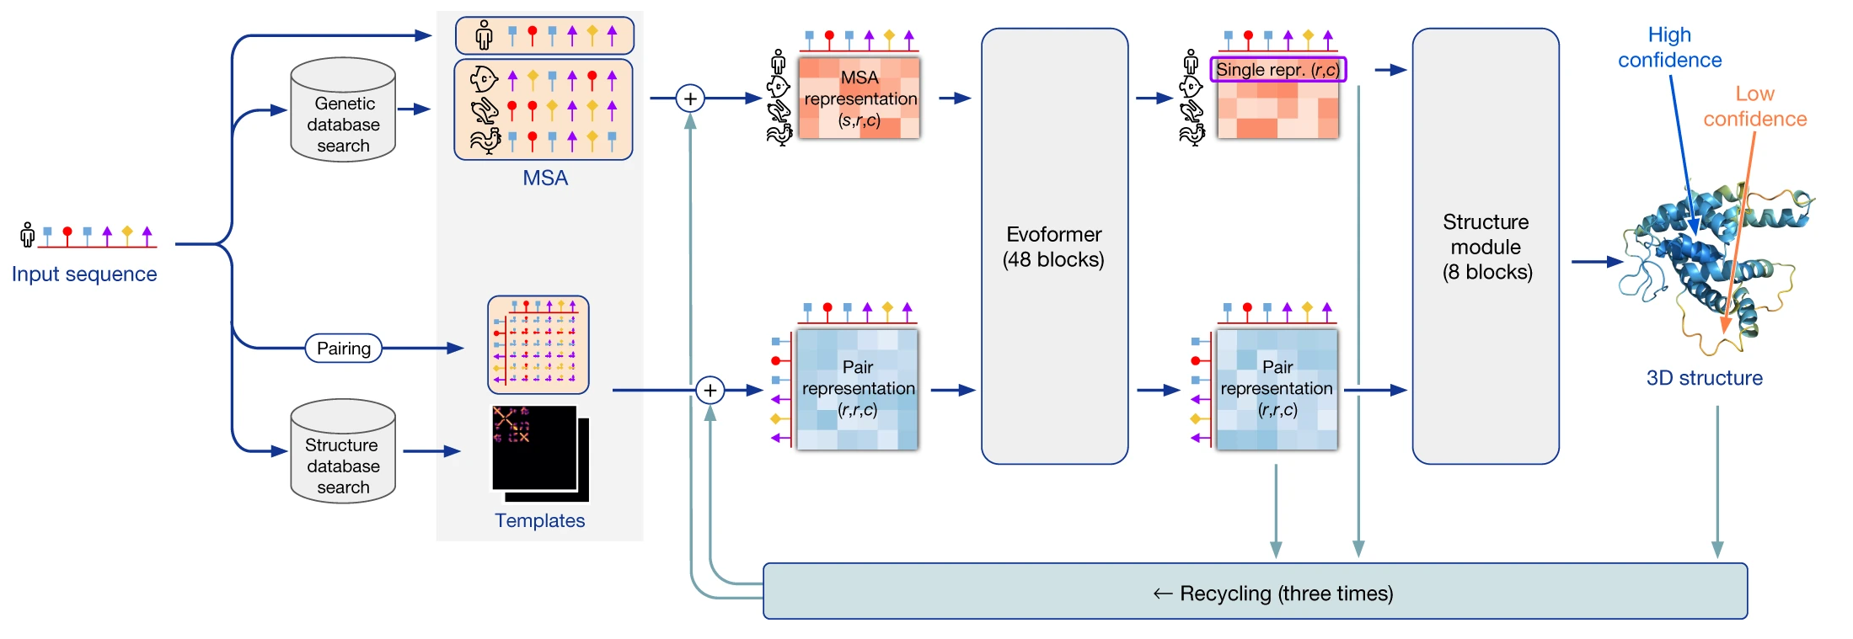
Stages of prediction
Amber
relaxation
Run inputs through 5 trained AlphaFold models (GPU)
5 or 25 structures predicted
sorted on confidence
Relax all structures (Amber)
Multiple sequence alignment (CPU)
Structural templates search

Slide 12
AlphaFold training
5 prediction models
Trained for
Frame-aligned point error (FAPE)
Minimize distance between predicted structure and ground truth
+ auxiliary losses (predict confidence by estimating when mistakes are made, physical constraints, …)
Trained on
PDB protein fragments (256-384 residues)

Slide 13
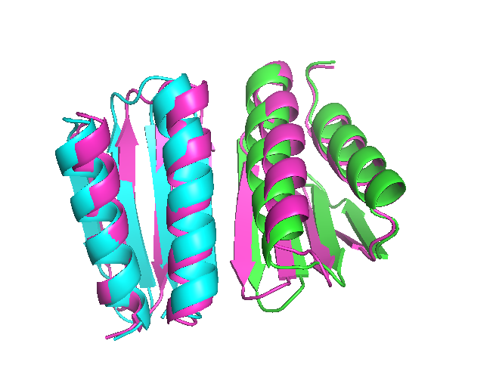
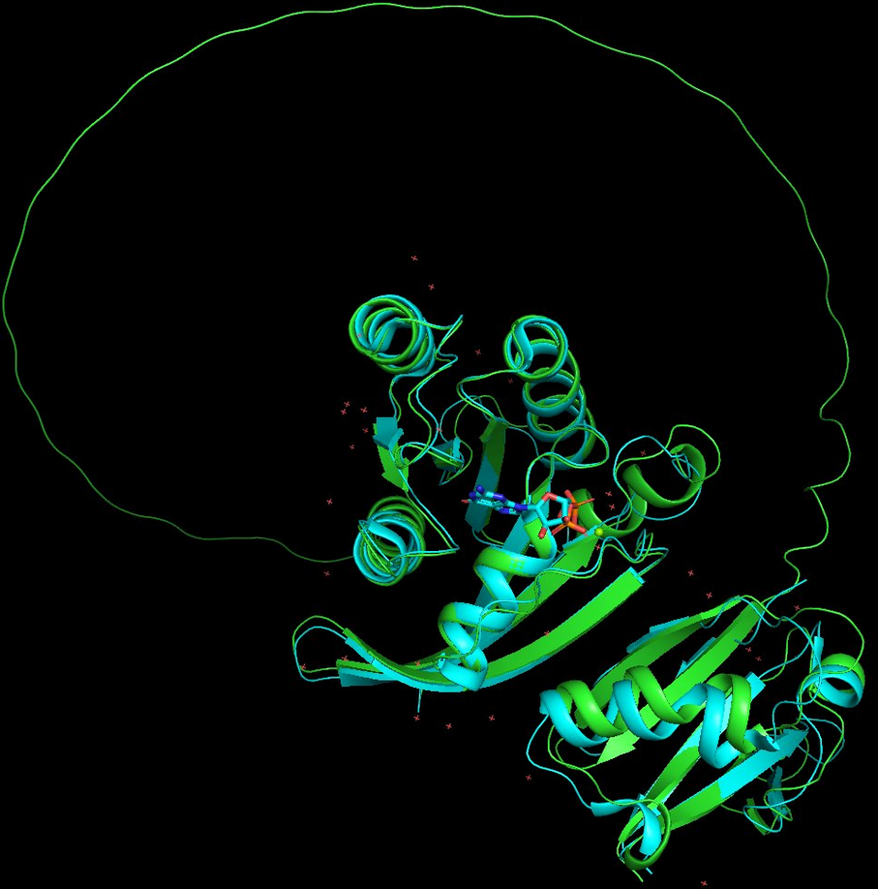

AlphaFold-multimer
2. Separate chains programmatically
3. AlphaFold-Multimer
1. Single chain with pseudolinker

Slide 14
Other protein folding software anno 2023

Slide 15
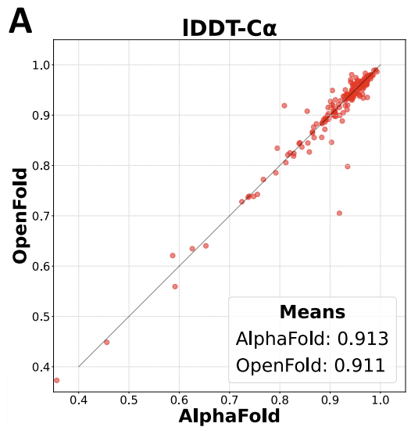
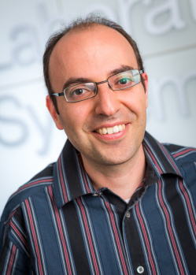
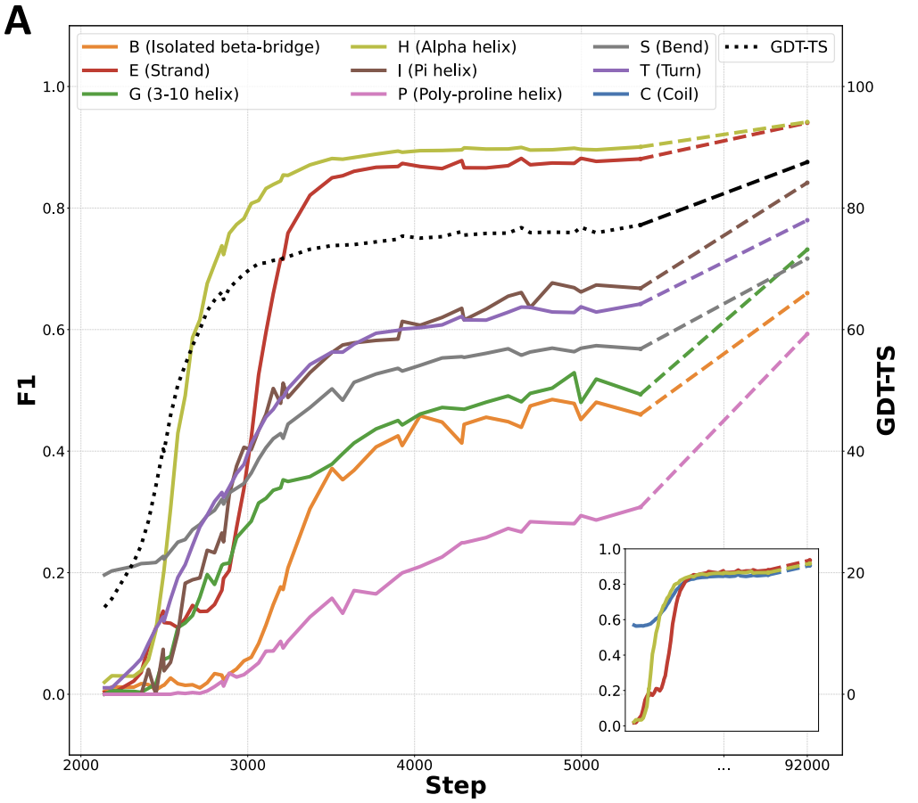
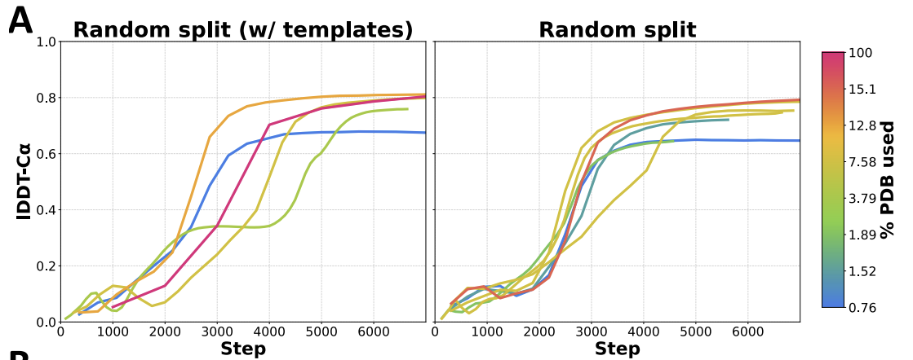
OpenFold: a faithful but trainable PyTorch reproduction of DeepMind’s AlphaFold2
AlQuraishi lab
+ analysis of the training process
https://github.com/aqlaboratory/openfold
https://www.biorxiv.org/content/10.1101/2022.11.20.517210v2.full.pdf

Slide 16
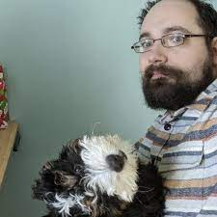
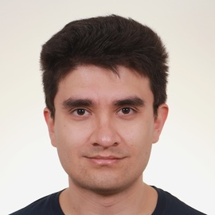
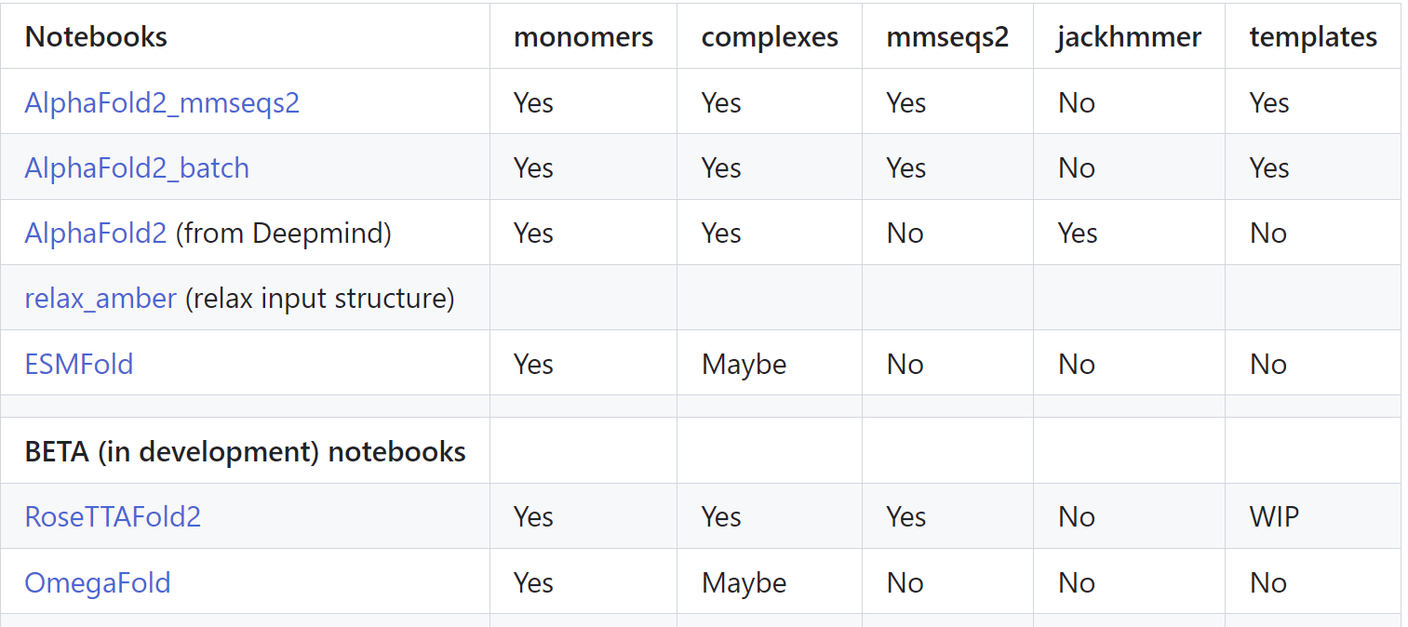
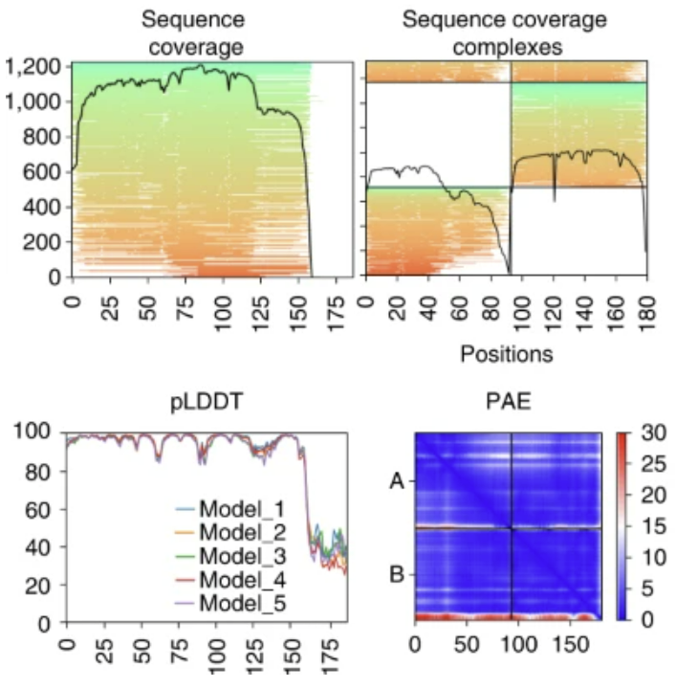
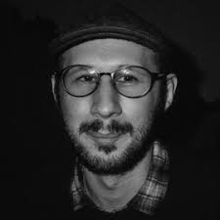

ColabFold: making protein folding accessible to all
Sergey Ovchinnikov
Milot Mirdita
Martin Steinegger
Early adopters of AF2 inference code using Google Colab
Series of Colab Notebooks + visualization code
MMSeqs2 for ultra-fast MSA generation
https://github.com/sokrypton/ColabFold
https://www.nature.com/articles/s41592-022-01488-1

Slide 17
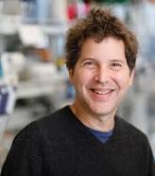
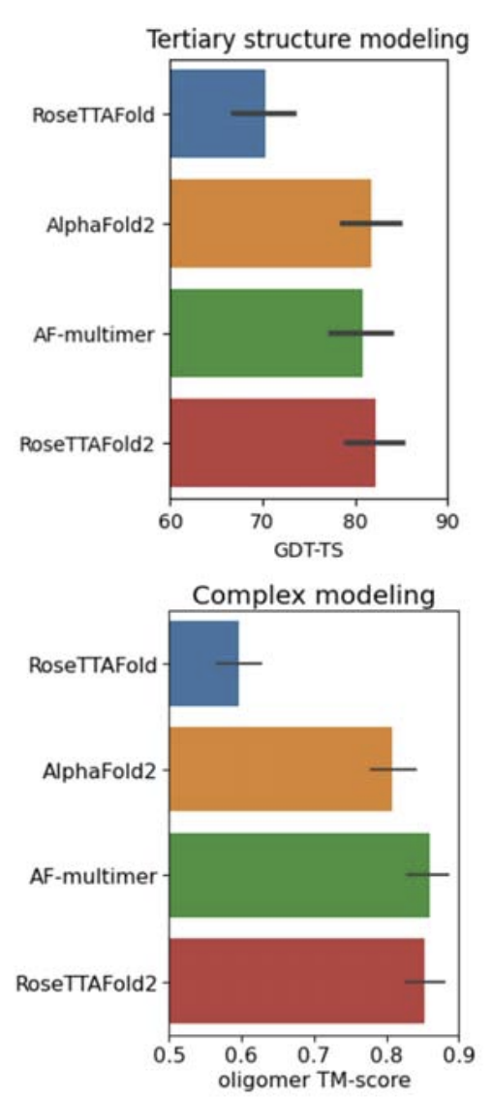
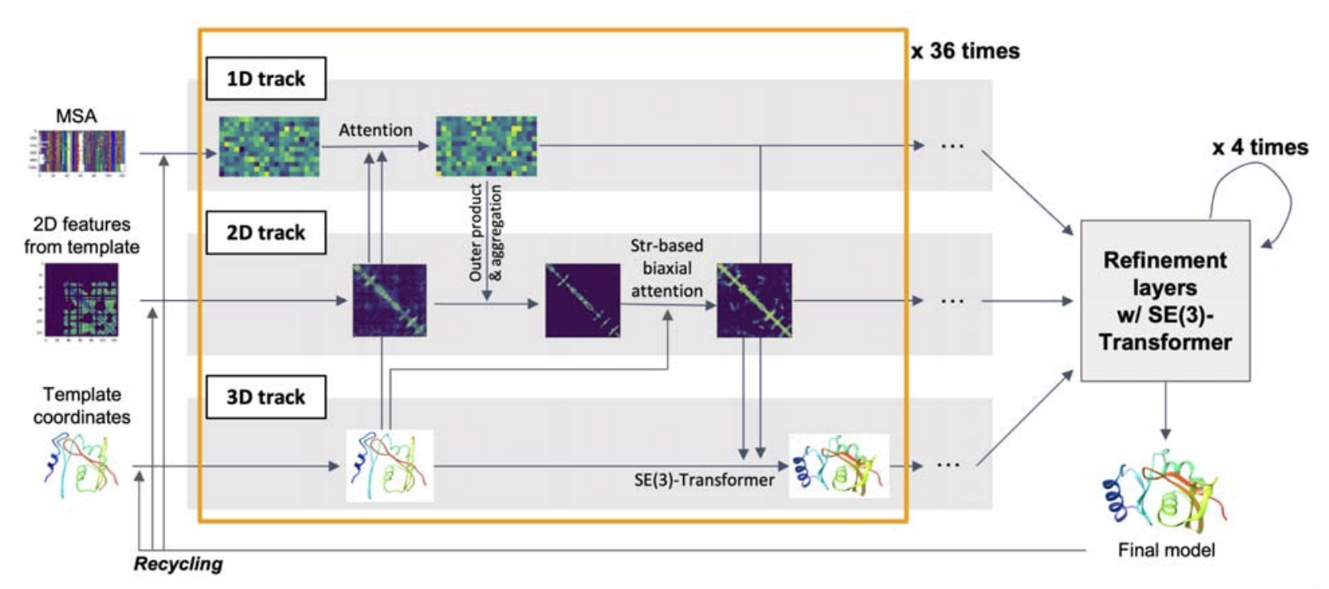

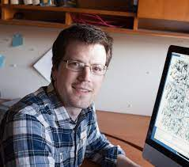
RoseTTAFold2: an improved method combining features of AF2+RF
David Baker
Minkyung Baek
Frank DiMaio
https://github.com/uw-ipd/RoseTTAFold2
https://www.biorxiv.org/content/10.1101/2023.05.24.542179v1

Slide 18
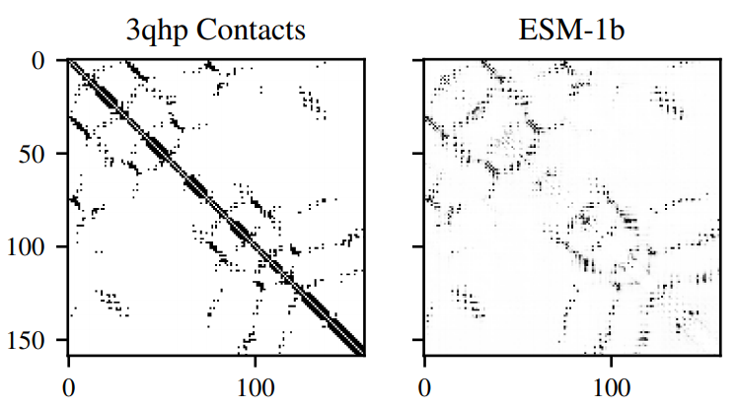
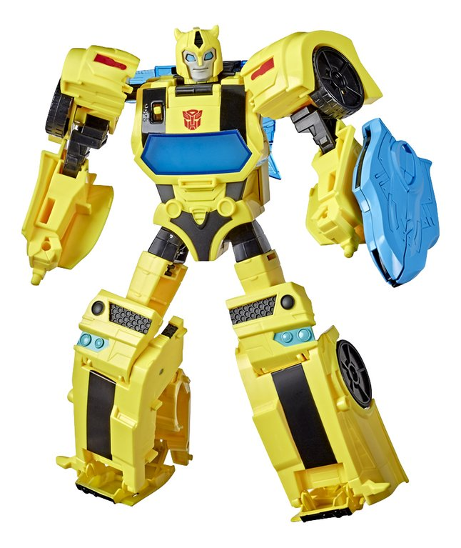
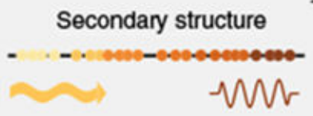
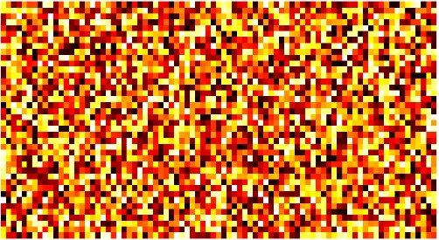
Protein language model-based predictors: OmegaFold and ESMFold
Main principle: MSA → pre-trained protein language model
PFMYFCWRTFGSWAYSFGYAWIYTGVGTALLIAA….
Rao2020
Alley2019
~ 768 - 1280
classification
A 0.11
C 0.04
…
Y 0.01

Slide 19
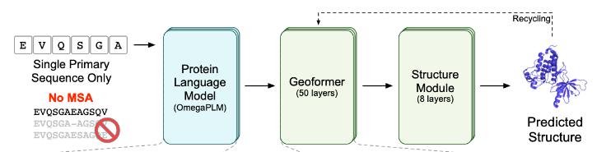
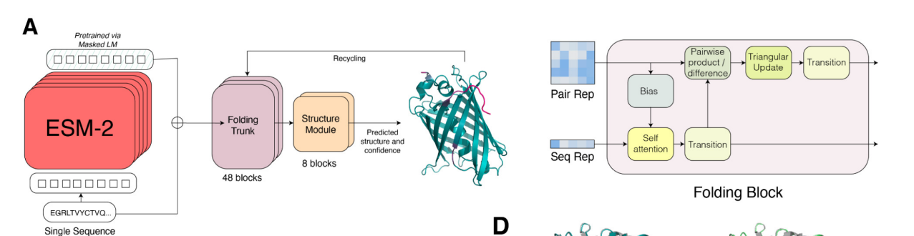
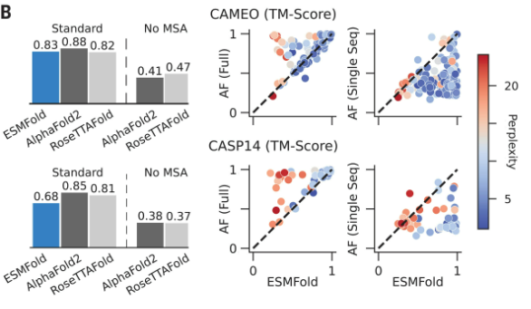
Protein-language-model-based predictors: OmegaFold and ESMFold
OmegaFold
ESMFold
08 aug:
Announced that ESMFold is discontinued
https://www.science.org/doi/10.1126/science.ade2574
https://esmatlas.com/resources?action=fold
https://github.com/facebookresearch/esm
https://www.biorxiv.org/content/10.1101/2022.07.21.500999v1
https://github.com/HeliXonProtein/OmegaFold

Slide 20

Access to AlphaFold predictions
Memory (RAM)
GPUs
Huge databases (~2.2 TB)

Slide 21





AlphaFold availability
1.
2.
3.
Colabfold

Slide 22
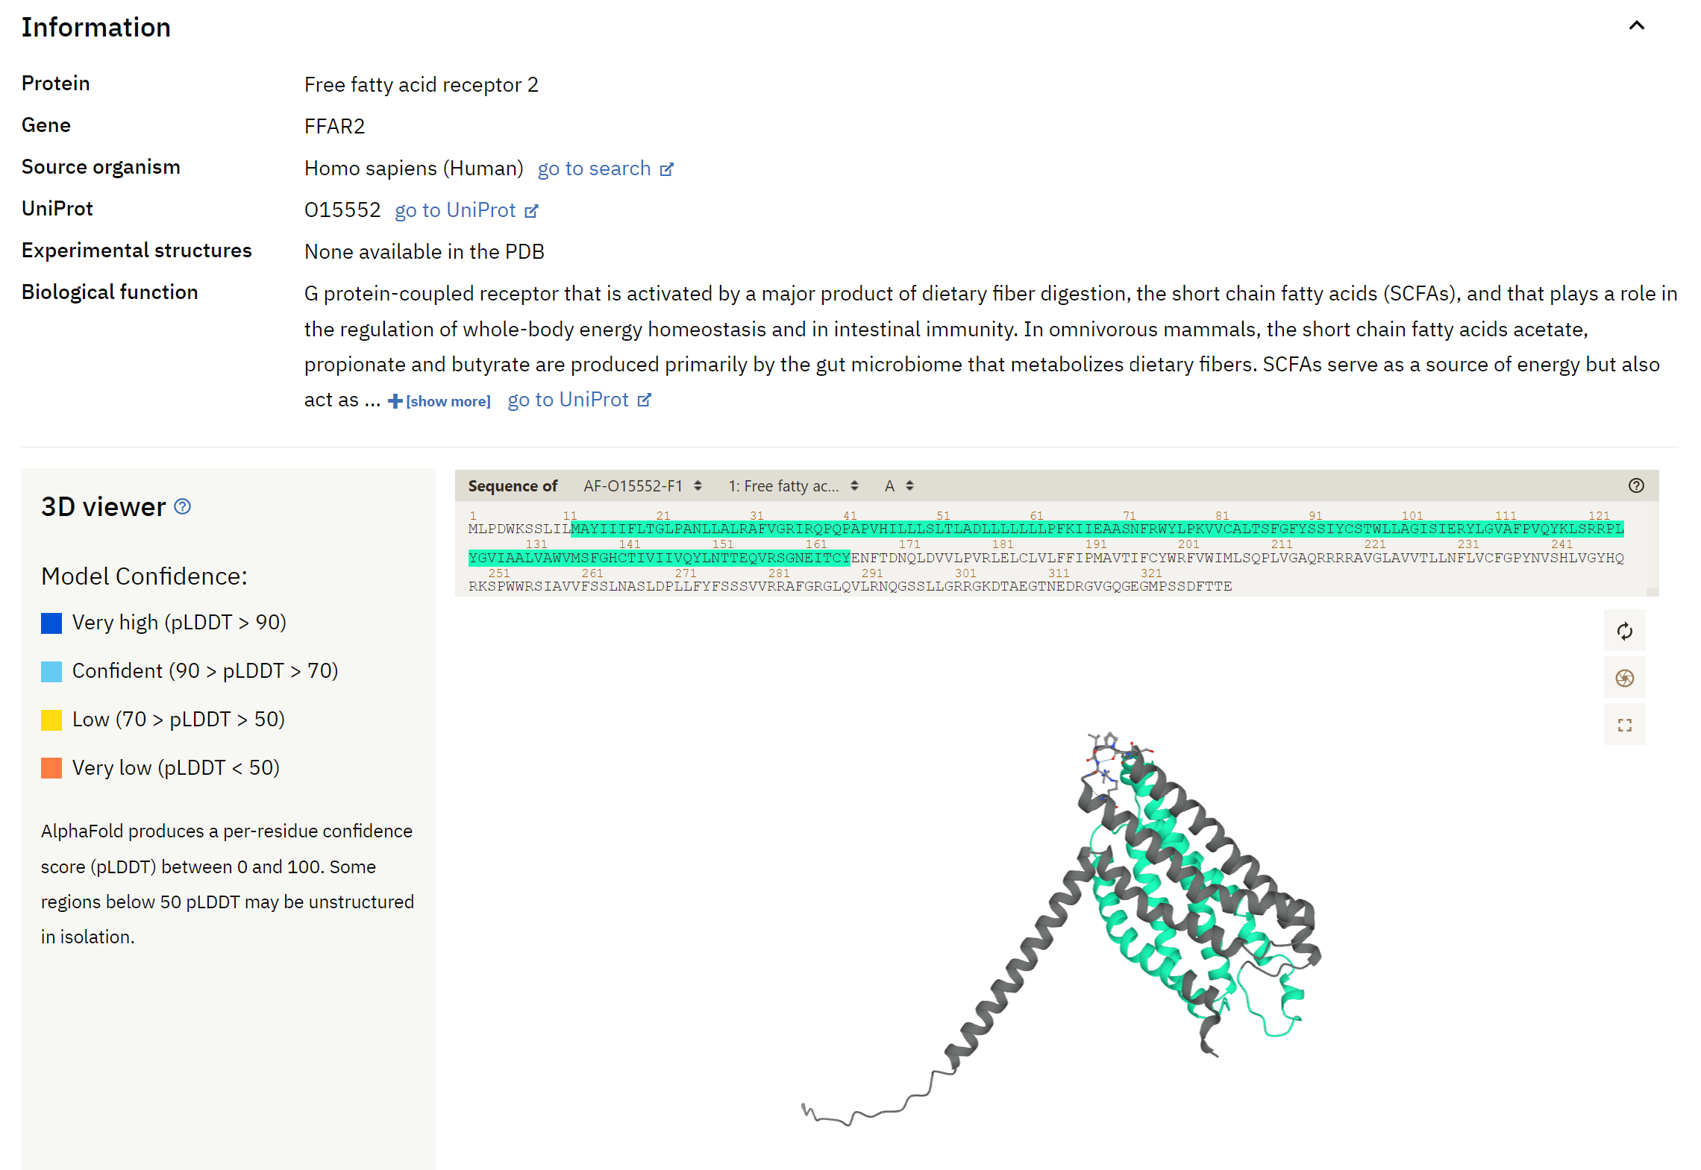
AlphaFoldDB (alphafold.ebi.ac.uk)
Predicted monomer structures
Coverage:
~ full UniProt
200 million proteins from 1 million species
16 < length < 2700 (SwissProt)
16 < length < 1280 (rest of UniProt)
! No multimers !

Slide 23
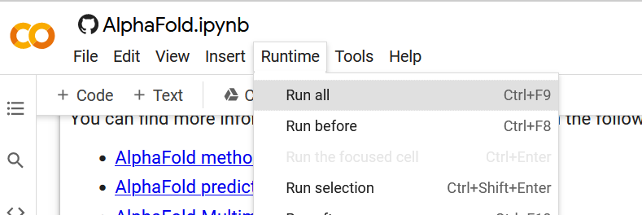
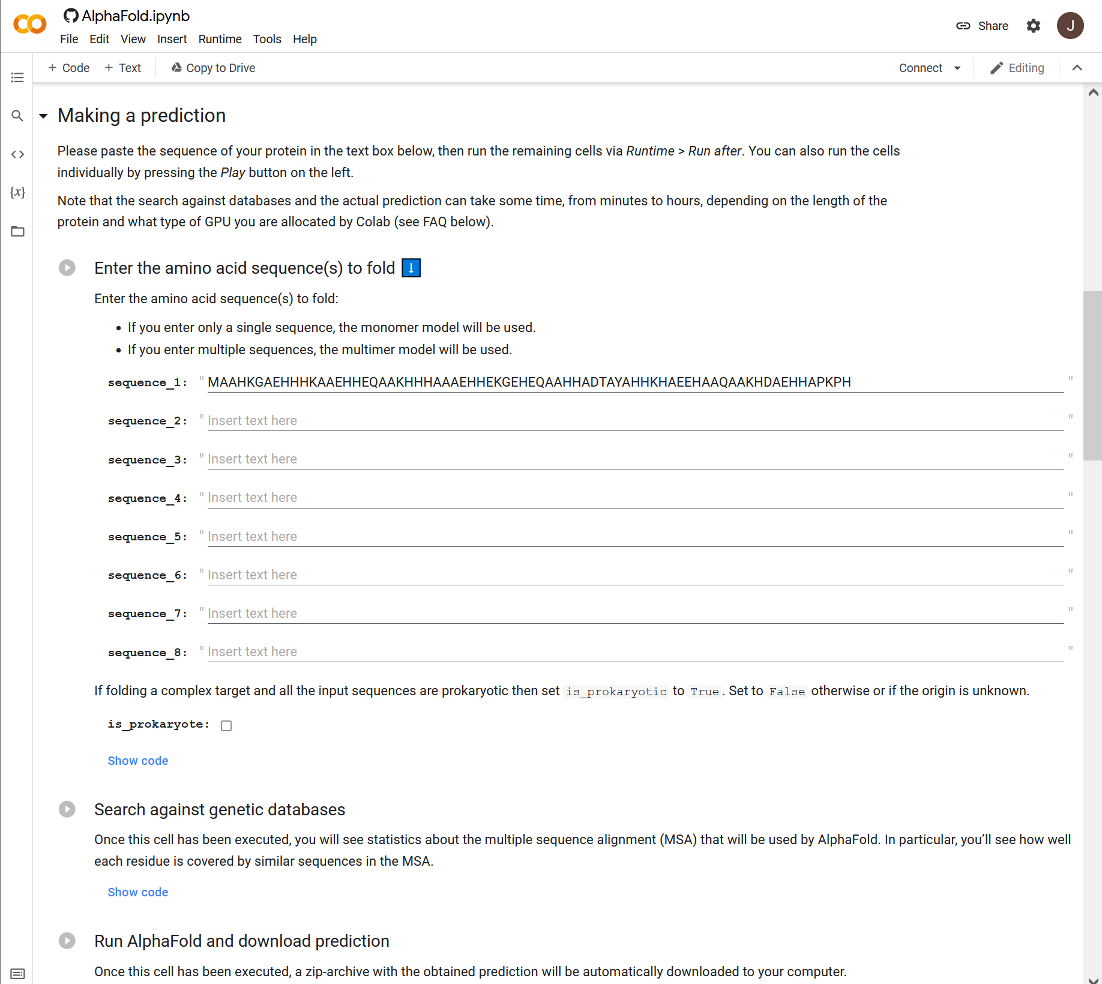
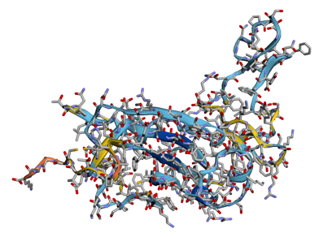
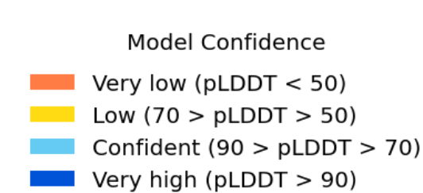
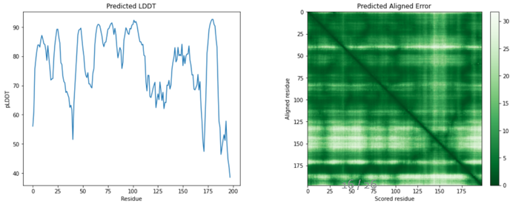
AlphaFold: Official Google Colab
3.
1.
4. Wait.
5.
2.
https://colab.research.google.com/github/deepmind/alphafold/blob/main/notebooks/AlphaFold.ipynb

Slide 24
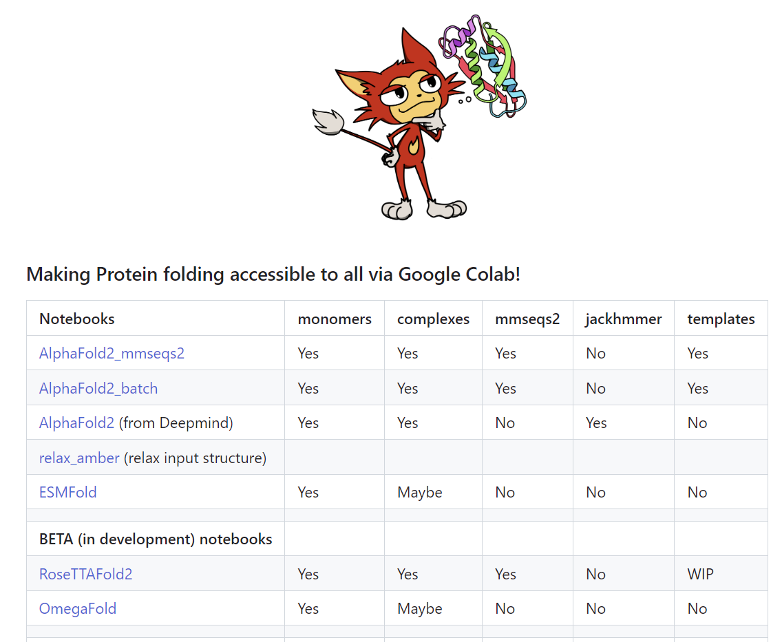
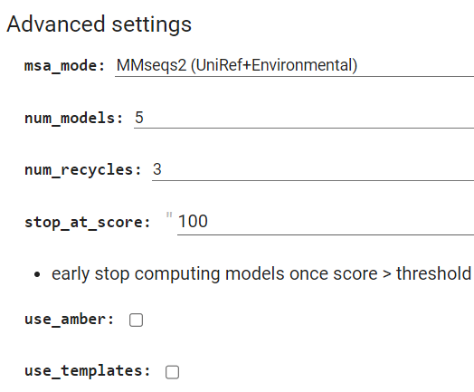
Efficiency + customizability via ColabFold

Slide 25

High-Performance Computing (HPC)
Software and databases
installed
State-of-the-art GPU/CPU/RAM hardware
Expert support
Queuing system for allocating resources

Slide 26
AlphaFold on HPC
Advantages:
Set up a large batches of experiments
Faster + GPUs have greater memory → longer sequences
No restricted availability (←→ Google Colab)
Available GPU servers (UGent):
Available GPUs KUL: 20 x 4 P100 (16GB) + 2 x 4 V100 (32GB)
Available GPUs UA: 2 x 2 P100 (16GB) + 1 x 4 A100 (40GB)
Available GPUs VUB: 4 x 2 P100 (16GB) + 10 x 2 A100 (40GB)
Available | joltik | 10 nodes | 4x V100 GPU per node (32GB) | 256 GiB RAM p/n | 800GB SSD p/n
Available | accelgor | 9 nodes | 4x A100 GPU per node (80GB) | ~500 GiB RAM p/n | 800GB SSD p/n
Tier 2

Slide 27
Computation time for different AlphaFold stages (on joltik)

Slide 28
Computation time for full runs on HPC-GPU, HPC-CPU and Google Colab (GPU)
Colab length limit

Slide 29
(Dis)advantages of the platforms
AlphaFold @ HPC
+ Put (multiple) in queue and wait
+ High memory GPUs = long seqs
- Unpredictable queue times
- Slow MSA search
Possibility for specialized scripts (e.g., VIBFold):
- Include MMSeqs2 as MSA search engine
- Extra customizability
- Batch queueing
https://elearning.vib.be/courses/alphafold/lessons/vibfold-on-the-hpc/
ColabFold @ Google Colab
+ MMSeqs2 for very fast MSA calculation
+ (some extra customizability)
+ automatic PAE plot generation
- Requires active session (!)
- Limited resource allocation in time
- Lower memory GPUs = shorter seqs
- No possibility for confidential information

Slide 30
How to run AlphaFold on the HPC

Slide 31
Set-up: requirements
https://docs.vscentrum.be/en/latest/access/getting_access.html
Necessary: VSC account (account set-up should have been done in advance)
Logging in can be done via:
(a) Internet browser
(b) SSH client
Public/private key pair and SSH client needed
Command line introduction:
https://elearning.bits.vib.be/courses/alphafold/lessons/alphafold-on-the-hpc/topic/basic-unix-commands/

Slide 32
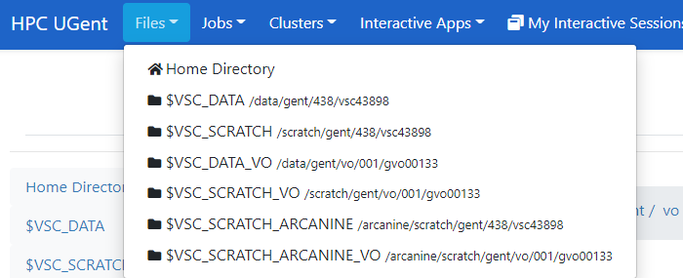




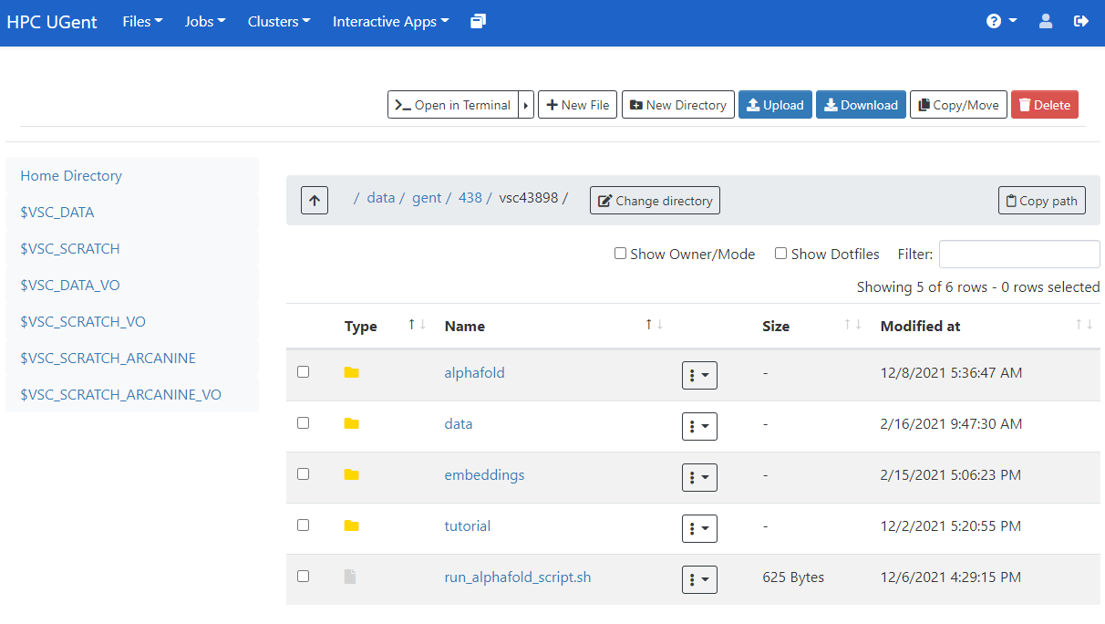
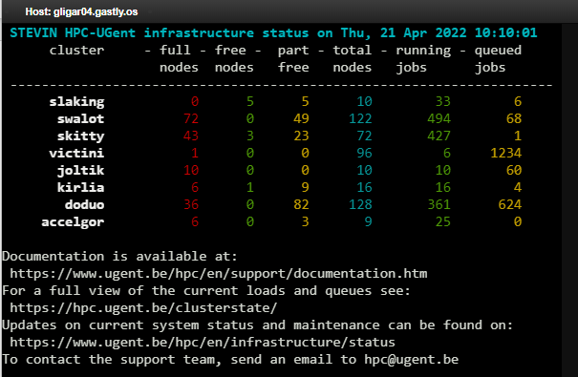
Set-up: logging in
login.hpc.ugent.be
transfer files
launch scripts

Slide 33
Set-up: directories and files
https://elearning.bits.vib.be/courses/alphafold/lessons/alphafold-on-the-hpc/topic/prepare-directories-and-files/
Default location when logging in
(~6GB)
Extra storage capacity
(~25GB)
When in a ‘virtual organization’
(~26TB shared)

Slide 34
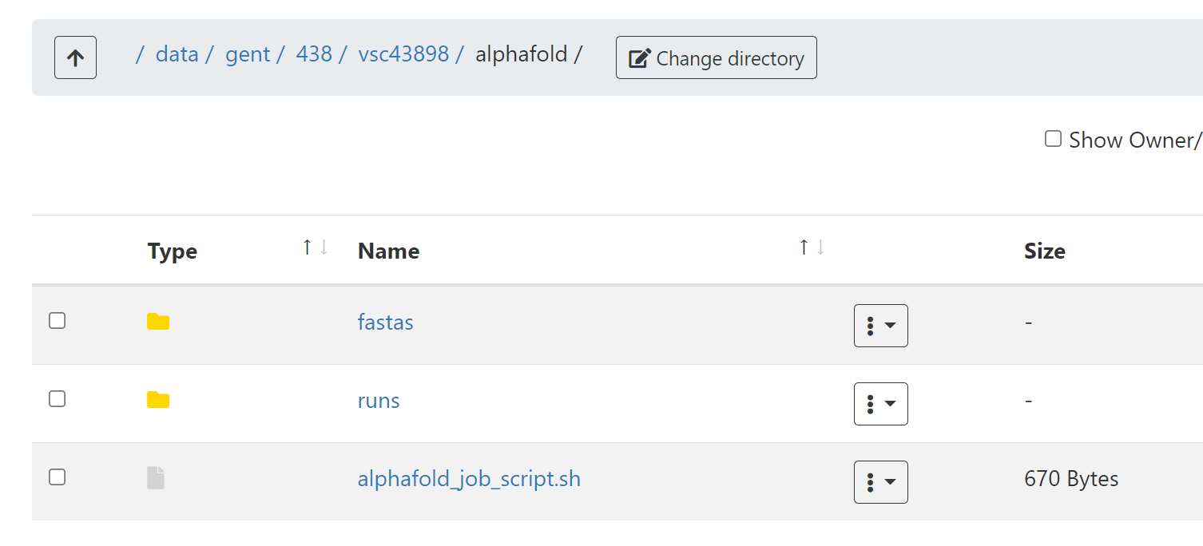
Set-up: directories and files
In $DATA_VSC: create directory alphafold
There:
Create directory fastas
Create directory runs
Download alphafold_job_script.sh
OR copy contents to a file,
OR right-click on Raw > Save link as,
OR use wget with the raw link (Raw > Copy link) on the command line directly
OR use mkdir on the command line,
OR use New directory on the web interface

Slide 35

Set-up: directories and files
In fastas: create/upload your FASTA file
OR via command line (nano, vim, …)
OR by uploading an existing file to the web interface
OR by creating + editing a new file via the web interface

Slide 36

Set-up: modify alphafold_job_script.sh
https://elearning.bits.vib.be/courses/alphafold/lessons/alphafold-on-the-hpc/topic/setting-up-the-job-script/
download link

Slide 37




Set-up: submitting and monitoring
Necessary step: select the appropriate cluster (joltik in this case)
you can check it using ml
!! During this session only:
priority access to joltik via
qsub alphafold_job_script.sh --pass=reservation=vib
After setting up the cluster and the files, submit your job!
- Only submit one job at a time (shared nodes)
- Walltime must not exceed 7 PM today! (for
reservation)
Check status
To cancel runs: use qdel

Slide 38




Monitoring + outputs
error file: tells when something goes wrong
output file: tells where output files are located
Troubleshooting:
https://elearning.bits.vib.be/courses/alphafold/lessons/alphafold-on-the-hpc/topic/troubleshooting/

Slide 39
AlphaFold outputs

Slide 40





AlphaFold output folder
Actual input given to the predictor (after MSA)
.pkl = specific python data format
Extra output information (including confidence)
.pkl = specific python data format
! More later !

Slide 41
AlphaFold output folder

Slide 42
Exercise: run a prediction on the HPC https://elearning.vib.be/courses/alphafold/lessons/vib-training-session-alphafold/topic/first-experiment-on-the-hpc/
For this training session:
Please limit yourself to 1 job at a time (to give everyone access to one GPU)
Add an extra flag in the job script

Slide 43
Evaluating & interpreting AlphaFold predictions

Slide 44


Metrics and scores to evaluate model accuracy
pTM: predicted TM-score
- global accuracy metric (score between 0 and 1)
pLDDT: predicted local distance difference test
- local (per residue) confidence metric
PAE: predicted alignment error
- assesses interdomain accuracy in multidomain proteins
- evaluation of protein-protein complexes
pLDDT plot
PAE plot

Slide 45
pTM-score: intrinsic model accuracy estimate
TM-score indicates the similarity between two structures by a score between 0 and 1, where 1 indicates a perfect match between two structures
The TM-score is intended as a more accurate measure of the global similarity of full-length protein structures than the often used RMSD measure (independent of protein length, less sensitive to local dissimilarity).
pTM score is the predicted TM-score between the structural prediction and the (unknown) true structure
Alphafold predictions (typically 5) are ranked based on the pTM score
References:
TM-score: Zhang Y and Skolnick J (2004). "Scoring function for automated assessment of protein structure template quality". Proteins
pTM score: Jumper et al., (2021). “Highly accurate protein structure prediction with AlphaFold”. Nature

Slide 46



pLDDT-score reflects local model accuracy
pLDDT: predicted local distance difference test
per residue confidence metric
Estimates agreement of local environment between true structure and prediction
structural models are coloured according to the pLDDT-metric (relative scale 1- 100):
Structural model for Human TSLP
4-helix bundle region
(high-confidence)
Signal sequence
Loop region
(low-confidence)
21
Notes:
How to asses to quality of the structural models?
predictions: predicted local distance difference test (pLDDT)
- pLDDT provides a per-residue condidence metric
- pLDDT provides an estimate for each residues on how well the local environment around each residue (mainchain + side chain conformations) matches the true (unknown) structure
- relative scale 1 – 100
- linear plot or colored-coded on structure (B-factor column in pdb file)
- low confidence regions are associated with disorder

Slide 47



pLDDT-score reflects local model accuracy
PyMOL session window
Pdb file is opened with a molecular graphics programs such as Pymol, ChimeraX or Yasara
AlphaFold model
colored by ‘B-factor’
Pdb file stores the coordinates and per-residue pLDDT-score
Model can easily be according to confidence level
color bfactor #1 palette alphafold
Low confidence
High confidence
pLDDT score
22
Notes:
Pdb file contains coordinates
for the structural models
Later a small tutorial will follow (color model according to B-factor, pLDDT

Slide 48
pLDDT-score reflects local model accuracy
pLDDT plot

Slide 49


PAE-plot evaluates interdomain accuracy
N
pLDDT --> metric assesing local structural quality/confidence
Prediction for
human LEPR
D1
PAE metric --> Predicted aligned error assesses inter-domain accuracy
PAE plot shows predicted error between all pairs of residues
Extracellular region only
PAE plot
D1
D2
D2
very high
D3
D3
D4
D4
D5
pLDDT
Intracellular loops
D5-6
very low
D5
Intracellular region
TM-helix
D5-6
C
Alphafold models can be very informative to delineate domains / functional regions (construct design).
Notes:
AF is not aware of the
cellular environement

Slide 50

Fitted AF2 model for human LEPR fitted in experimental cryo-EM map for Leptin-LEPR complex
Tsirigotaki et al., Nat Struct Mol Biol., 2023
doi: 10.1038/s41594-023-00941-9

Slide 51

P54725
Q5VSL9
https://www.deepmind.com/
Notes:
https://www.deepmind.com/publications/enabling-high-accuracy-protein-structure-prediction-at-the-proteome-scale

Slide 52

AlphaFold-Multimer: prediction of complexes
AlphaFold model trained specifically for multimeric protein complexes
Works relatively well
Successful prediction of interface in 70% of cases
High accuracy complex model in 26% of cases
Higher performance for homomeric interfaces than heteromeric interfaces
Evolutionary information is harder to access for heteromeric assemblies
Algorithm is (generally) not able to predict binding of antibodies/nanobodies
No evolutionary information available
A2B2C2 heteromer
Ground truth
Evans*, O’Neill*, Pritzel*, Antropova* et al., BioRxiv, 2022
https://www.biorxiv.org/content/10.1101/2021.10.04.463034v2
41

Slide 53

AlphaFold-Multimer: evaluation metrics
ipTM: interface pTM
scores the interactions between residues of different chains (protein interface)
a weighted combination of pTM and ipTM as our model confidence metric, in order to account for some intra-chain confidence in the model ranking: model confidence = 0.8 · ipTM + 0.2 · pTM
Evans*, O’Neill*, Pritzel*, Antropova* et al., BioRxiv, 2022
PAE plot
chain A
PAE plot
Predicted aligned error (PAE) shows the predicted error between all pairs of residues
Plot shows accurate predictions for the individual domains, but an inaccurate geometry of the predicted complex
chain A: residues 1-380
chain B: residues 381-620
chain B
A-B interface
42

Slide 54
Exercise: Using the interactive AlphaFoldDB interface
https://elearning.vib.be/courses/alphafold/lessons/vib-training-session-alphafold/topic/analyze-the-prediction-for-usp7-on-alphafolddb/

Slide 55
Exercise: Set up Multimer prediction
https://elearning.vib.be/courses/alphafold/lessons/vib-training-session-alphafold/topic/run-alphafold-multimer/

Slide 56
Example use-case

Slide 57

Prediction of a cytokine-receptor complex
Cytokine binding induces receptor dimerization and signaling
Spangler et al., Annu Rev Immunol, 2015

Slide 58




Prediction of the proinflammatory signaling complex mediated by human TSLP
Target proteins:
Human TSLP, Uniprot ID Q969D9, residues 29-159
(without signal peptide)
?
Extracellular assembly
Human TSLP-R ectodomain, Uniprot ID Q9HC73,
residues 23-231
Human IL-7R ectodomain, Uniprot ID P16871, residues 21-239

Slide 59
Input text file with sequences in fasta format
>hTSLP_sp|Q969D9|29-159
YDFTNCDFEKIKAAYLSTISKDLITYMSGTKSTEFNNTVSCSNRPHCLTEIQSLTFNPTA
GCASLAKEMFAMKTKAALAIWCPGYSETQINATQAMKKRRKRKVTTNKCLEQVSQLQGLW
RRFNRPLLKQQ
>hIL7Ra_sp|P16871|21-239
ESGYAQNGDLEDAELDDYSFSCYSQLEVNGSQHSLTCAFEDPDVNITNLEFEICGALVEV
KCLNFRKLQEIYFIETKKFLLIGKSNICVKVGEKSLTCKKIDLTTIVKPEAPFDLSVVYR
EGANDFVVTFNTSHLQKKYVKVLMHDVAYRQEKDENKWTHVNLSSTKLTLLQRKLQPAAM
YEIKVRSIPDHYFKGFWSEWSPSYYFRTPEINNSSGEMD
>hTSLPR_sp|Q9HC73|23-231
QGGAAEGVQIQIIYFNLETVQVTWNASKYSRTNLTFHYRFNGDEAYDQCTNYLLQEGHTS
GCLLDAEQRDDILYFSIRNGTHPVFTASRWMVYYLKPSSPKHVRFSWHQDAVTVTCSDLS
YGDLLYEVQYRSPFDTEWQSKQENTCNVTIEGLDAEKCYSFWVRVKAMEDVYGPDTYPSD
WSEVTCWQRGEIRDACAETPTPPKPKLSK

Slide 60



pLDDT plot indicates disordered regions
TLSP
IL-7Ra
TLSPR
Colored by pLDDT
Colored by chain
Low confidence
High confidence
C
N
N
C
C
TLSP
IL-7Ra
N
TLSPR

Slide 61
pLDDT plot indicates disordered regions
pLDDT-score (B factor column)
Open pdb file with text editor
ATOM 1 N TYR A 1 7.960 6.236 -30.112 1.00 95.23 N
ATOM 2 H TYR A 1 7.706 6.779 -29.299 1.00 95.23 H
ATOM 3 H2 TYR A 1 7.427 6.587 -30.895 1.00 95.23 H
ATOM 4 H3 TYR A 1 8.951 6.321 -30.287 1.00 95.23 H
ATOM 5 CA TYR A 1 7.596 4.833 -29.851 1.00 95.23 C
ATOM 6 HA TYR A 1 7.726 4.235 -30.753 1.00 95.23 H
ATOM 7 C TYR A 1 6.129 4.814 -29.477 1.00 95.23 C
ATOM 8 CB TYR A 1 8.472 4.249 -28.737 1.00 95.23 C
ATOM 9 HB2 TYR A 1 9.497 4.189 -29.103 1.00 95.23 H
ATOM 10 HB3 TYR A 1 8.460 4.920 -27.879 1.00 95.23 H
ATOM 11 O TYR A 1 5.713 5.734 -28.785 1.00 95.23 O
ATOM 12 CG TYR A 1 8.043 2.871 -28.291 1.00 95.23 C
ATOM 13 CD1 TYR A 1 7.295 2.723 -27.108 1.00 95.23 C
ATOM 14 HD1 TYR A 1 7.036 3.582 -26.508 1.00 95.23 H

Slide 62

PAE plots indicates an accurate protein complex geometry

Slide 63

PAE plots indicates an accurate protein complex geometry
TLSP
TLSP
IL-7Ra
TLSPR
IL-7Ra
TLSPR
TLSP
IL-7Ra
TLSPR

Slide 64



Comparison with experimental crystal structure?
Crystal packing of TSLP:TSLPR:IL7-R complexes
Notes:
On the left you can see a picture of a protein crystal. A protein crystal consists of a an ordered 3-dimensional array of protein molecules that are thightly packed together. To facilitate the formation of high quality crystalline lattices a highly pure protein preparation is needed.

Slide 65


Comparison with experimental crystal structure?
Experimental crystal structure to 2.56 Å resolution (pdb 5j11)
Alphafold-Multimer prediction
Notes:
Executive: RMSD = 0.586 (452 to 452 atoms)

Slide 66

Comparison with experimental crystal structure?
Rmsd-value =
0.59 Å for 452 aligned Cα atoms

Slide 67
Prediction of the Leptin:LepR complex
Structural basis for complex formation?
“Expected” 2:2 stoichiometry based on related cytokine-receptor complexes
Ig
+
CRH2
Leptin
CRH2
Ig
LepR
fragment
Ig’
CRH2’

Slide 68

CRH2
Ig
Ig’
CRH2’

Slide 69


Slide 70


Slide 71


Slide 73




2:2
3:3
4:4
5:5

Slide 74
3 X Leptin
3 X LepR
Ig’
Leptin
CRH2
LepR

Slide 75






Leptin and LEP-R form 3:3 cytokine receptor complexes in solution
SEC-MALLS
Analytical ultracentrifugation (AUC)
1:1
3:3
K_{D}= 1.4 μM
Tsirigotaki et al., Nat Struct Mol Biol., 2023
doi: 10.1038/s41594-023-00941-9
Notes:
We then switched our focus the the full-length extracellular leptin complex assembly. Via biophyscial studies using SEC-MALLS and analytical ultracentrifugation (in colloboration with Catherine Birck at the University of Strassbourg) we were able to show that leptin and the full-length LEPR ectodomain can form 3:3 complexes in solution (in reversible and concentration dependent manner) with an apparent affinty 1.4 micromolar. We next employed cryo-EM to possibly visulazie this higher-order leptin complex.

Slide 76



Experimental structures for 3:3 Leptin:LEP-R complex
Cryo-EM map
Real space refined cryo-EM model
55k particles
3:3 mLep:LEP-R_{IgCRH2} crystal structure
r.m.s.d. = 1.6 Å for 1218 aligned Calpha pairs
Notes:
This is resulting atomic cryo-EM model after real space refinement. An overaly with the previously determined crystal structures shows that the assemblies determined by cryo-EM and X-ray crystallography are highly similar.

Slide 77


Comparison between AF2-multimer prediction and experimentally determined X-ray structure
AF2-Multimer model
RMSD = 1.4 Å (for 1194 aligned Cα atoms)

Slide 78
AlphaFold-Multimer and complex stoichiometry
Interpret the AF2-Multimer results with caution if the stoichiometry was not experimentally determined: AF2-Multimer returns the stoichiometry you asked for, which may or may not correspond to the biological assembly. You can also evaluate a number of different stoichiometries.
A more unbiased strategy for multimeric assemblies is to predict the different protein:protein interfaces seperately and then concatenate the different predictions via structural superposition

Slide 79

Observed 3:3 assembly is in agreement with structural predictions by AlphaFold multimer
Tsirigotaki et al., Nat Struct Mol Biol., 2023
doi: 10.1038/s41594-023-00941-9
Notes:
We also use AlphaFold Multimer to predict the confomration of the lepr IgCRH2 fragment and the site II and site III interactions. The resulting models correspond remarkably well to the assembly in the crystal structures adding further relevance to this assembly mode.

Slide 80


Slide 81


Slide 82


Slide 83


Slide 84


Slide 85


Slide 86


Presence of interacting partner(s) can increase pLDDT score
LEPR
LEPR
JAK2

Slide 87

Presence of interacting partner(s) can increase pLDDT score
LEPR
LEPR
JAK2
JAK2

Slide 88
Pitfalls of AlphaFold

Slide 89
AlphaFold: uncertainties and potential pitfalls
Only prediction of proteins and protein complexes (no nucleic acids)
Low accuracy of regions where few sequences are available for alignment
Limited utility on Ab/Nb structure or complex predictions
Low accuracy of intrinsically unstructured regions
Limited information on structural dynamics / conformational states and protein stability
Varying accuracy of multimeric assemblies
No information on co-factors/ligands/post-translational modifications
No post-translational processing, no compartmentalization of transmembrane assemblies

Slide 90





Limited utility on Ab/Nb structure or complex predictions
VHH72 + SARS-CoV-2
VHH72 + SARS-CoV-1
Average error on predictions for different parts of nanobodies
Green: PDB structure
Cyan: predicted by AlphaFold

Slide 91

AlphaFill: filling models with ligands/co-factors
Algorithm based on sequence and structure similarity
AlphaFold sequence is BLASTed against database with experimental structures (PDB)
Adding missing small molecules/ions from experimentally determined structures to AlphaFold models
BLAST hits are checked for compounds of interest and filtered for homology
Hits are structurally aligned with AlphaFold models
Compounds are integrated into AlphaFold models
Hekkelman et al., Nature Methods, 2022
https://doi.org/10.1038/s41592-022-01685-y
43

Slide 92

AlphaFill: filling models with ligands/co-factors
Sodium ion
Retinal
Hekkelman et al., Nature Methods, 2022
https://doi.org/10.1038/s41592-022-01685-y
44

Slide 93

AlphaFill: filling models with ligands/co-factors
Human myoglobin
‘transplanted’ Heme group
Hekkelman et al., Nature Methods, 2022
https://doi.org/10.1038/s41592-022-01685-y
45

Slide 94
Exercise: Generate PAE/PLDDT using python script
https://elearning.vib.be/courses/alphafold/lessons/vib-training-session-alphafold/topic/generate-pae-plddt-plots/

Slide 95
Exercise: Display AlphaFold predictions and error estimates using ChimeraX
https://elearning.vib.be/courses/alphafold/lessons/vib-training-session-alphafold/topic/display-alphafold-predictions-and-error-estimates-using-chimerax

Slide 96
Exercise: Run ColabFold on Google Colab
https://elearning.vib.be/courses/alphafold/lessons/vib-training-session-alphafold/topic/run-colabfold-on-google-colab/

Slide 97
Exercise: Run ESMFold via web interface
https://elearning.vib.be/courses/alphafold/lessons/vib-training-session-alphafold/topic/run-esmfold-via-web-interface/

Slide 98
Exercise: Align & analyze predictions for SARS-CoV-2 RBD + VHH-E complex
https://elearning.vib.be/courses/alphafold/lessons/vib-training-session-alphafold/topic/analyze-the-predicted-sarscov2-vhh-e-complex/

Slide 99
Extra HPC scripts + support
Extra possibilities to run on the HPC:
VIBFold: more streamlined + batch AlphaFold runs
https://elearning.vib.be/courses/alphafold/lessons/vibfold-on-the-hpc/
ESMFold / OmegaFold
→ No explicit installation, but possible to run in batches on HPC as well, using a python virtual environment
OpenFold
→ Installed on HPC
AlphaPulldown
→ Still being installed
Extra HPC documentation: https://docs.hpc.ugent.be/alphafold

Slide 100


Acknowledgements
Jasper Zuallaert
Kenneth Verstraete
Alexander Botzki
Janick Mathys
Kenneth Hoste

